Slide 1
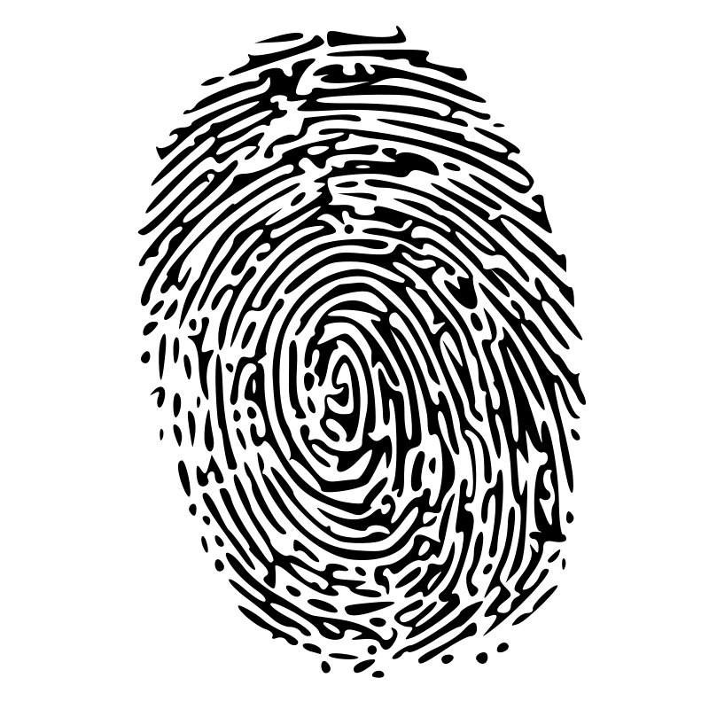
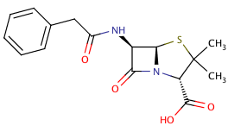
Fingerprinting Chemical Structures
Rajarshi Guha
https://github.com/rajarshi/ctpa-fingerprints

Slide 2
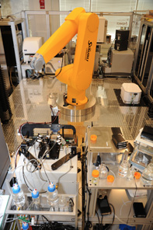
High Throughput Screening
Test thousands to hundreds of thousands of compounds in one or more assays
Biochemical, genetic, pharmacological assays
Employs a robotic platform
Rapidly identify novel modulators of biological systems
Infectious agents
Cellular basis of diseases

Slide 3
Goal of HTS
Rapidly screen large compound collections
Efficiently identify real actives
Test them in slower, accurate, expensive screens
Use the data to learn what types of compounds tend to be active
Use the model to suggest more compounds to screen

Slide 4
HTS Data Types
Categorical – active/inactive or toxic/nontoxic
Continuous
Single point
Dose response
Multiple readouts
Might read at different wavelengths or timepoints
More complex when dealing with imaging
These (usually) represent the dependent variable

Slide 5
Independent Variable(s)
HTS tests the activity of a molecule – the molecule is our “independent variable”
Need to describe the molecular structure
Various discrete or real-valued descriptors
Surfaces (3D)
Binary fingerprints

Slide 6
Fingerprint Representation
Lots of types of ﬁngerprints
Indicates the presence or absence of a structural feature
Length can vary from 166 to 4096 bits or more
Fingerprints usually compared using the Tanimoto metric

Slide 7
What Can I Use Them For?
Search
Given a potent active molecule, find similar ones (or dissimilar, but also potent)
Prediction
Given a set of active & inactive molecules build a model to predict which members from a large collection will be active
Clustering
Given a set of molecules, do they cluster into structurally different groups?

Slide 8
Fingerprints in R
The fingerprint package supports I/O, manipulation, similarity methods, and various utility methods
A fingerprint is a S4 object
Create them manually
Read them in from files
new("fingerprint", nbit = 1024, bits = c(1,4,5,100,200))
fp.read('data/cdk.fp', size=1024, lf=cdk.lf)

Slide 9
Getting Fingerprints
You can also generate fingerprints from chemical structures using the rcdk package
If you’re not doing cheminformatics you can read in your own FP data by implementing a line reader
See cdk.lf, moe.lf, bci.lf

Slide 10
Random Fingerprints
Useful for benchmarking, generating null distributions, exploring effects of bit density
## How long does a similarity matrix calculation take as a function of fp length?
nfp <- 300
sizes <- c(64, 128, 512, 1024, 4096, 8192)
times <- sapply(sizes, function(size) {
fps <- lapply(1:nfp, function(i) random.fingerprint(size, size * 0.35))
system.time(junk <- fp.sim.matrix(fps))[3]
})
## For a given length, how does bit density affect calculation time?
densities <- c(0.1, 0.25, 0.5, 0.75, 0.95)
times <- sapply(densities, function(density) {
fps <- lapply(1:nfp, function(i) random.fingerprint(1024, 1024 * density))
system.time(junk <- fp.sim.matrix(fps))[3]
})

Slide 11
Random Fingerprints

Slide 12
Compare Similarity Metrics
fps <- fp.read('data/cdk.fp', size=881,
lf=cdk.lf, header=TRUE)[1:500]
s.tanimoto <- fp.sim.matrix(fps,
method='tanimoto')
s.dice <- fp.sim.matrix(fps, method='dice')
d <- rbind(data.frame(method='Tanimoto',
s=as.numeric(s.tanimoto)),
data.frame(method='Dice',
s=as.numeric(s.dice)))
More than 20 similarity metrics
Some are in written in C, so very fast, applicable to larger fingerprint collections
Others are in pure R, slow

Slide 13
Predicting with Fingerprints
Read in fingerprints & convert to matrix form
See
data/solubility.csv
data/solubility.maccs
33,182 observations of solubility
57,857 fingerprints
Requires some data wrangling before modeling
OOB estimate of error rate: 22.37%
Confusion matrix:
high low medium class.error
high 181 52 621 0.78805621
low 35 5611 4598 0.45226474
medium 89 2029 19965 0.09591088

Slide 14
Predicting with Fingerprints
The model will use MACCS keys
166 bits
Each bit is associated with a structural feature
Low resolution, somewhat simplistic
Data comes in a non-standard format, so we must implement our own line reader
Classification problem – predict low/medium/high solubility

Slide 15
Predicting with Fingerprints
sol <- read.csv('data/solubility.csv', header=TRUE)
fps <- fp.read('data/solubility.maccs', header=FALSE, size=166,
lf=function(line) {
toks <- strsplit(line, " ")[[1]]
title <- toks[1]
bits <- as.numeric(toks[2:length(toks)])
list(title, bits, list())
})
## Extract fingerprint for which we have a label
common <- which( sapply(fps, function(x) x@name) %in% sol$sid )
fps <- fps[common]
## Order the fingerprints & data
sol <- sol[order(sol$sid),]
fps <- fps[order(sapply(fps, function(x) as.integer(x@name)))]
## Make X matrix
fpm <- fp.to.matrix(fps)
## Model!
library(randomForest)
m1 <- randomForest(x=fpm, y=as.factor(sol$label))

Slide 16
Predicting with Fingerprints
We can then use the RF variable importance measure
Features important for predictive performance
Presence of aromatic rings
Presence of charged atoms
Presence of 6-membered rings
N & O atoms connected in a chain
Chemically sensible
https://github.com/cdk/cdk/blob/master/descriptor/fingerprint/src/main/resources/org/openscience/cdk/fingerprint/data/maccs.txt

Slide 17
Clustering with Fingerprints
Generate a distance matrix directly from a list of fingerprints
fps <- fp.read('data/cdk.fp',
size=881,
lf=cdk.lf)[1:500]
sims <- fp.sim.matrix(fps)
dmat <- as.dist(1-sims)
clus <- hclust(dmat)
par(mar=c(1,4,1,1))
plot(clus, label=FALSE, xlab='', main='’)
Exercise: How do clusters vary with similarity metric and/or fingerprint type?

Slide 18
Comparing Data Sets
How do we compare two sets of chemical structures?
Sizes may be different, and very large
Pairwise?
O(N²) running time
Need to aggregate the resultant pairwise values

Slide 19
Comparing Data Sets
How do we compare two sets of chemical structures?
Sizes may be different, and very large
Distributions?
Of what?
Can lead to multiple ways to generate a comparison
Data fusion?

Slide 20
Bit Spectrum
Vector summary of the fingerprints for a dataset
Defined as the fraction of times a bit position is set to 1, for each bit position
~ 10K molecules

Slide 21
Bit Spectrum
Now comparison of two datasets is a O(1) operation – independent dataset size
Simply take the difference of the two bit spectra
e.g.: Compare ~ 800 solubles with > 30k insolubles
## make two subsets and generate bit spectra
sol.idx <- which(sol$label == 'high')
insol.idx <- which(sol$label != 'high')
sol.bs <- bit.spectrum(fps[sol.idx])
insol.bs <- bit.spectrum(fps[insol.idx])
## display a difference plot
bsdiff <- sol.bs - insol.bs
d <- data.frame(x=1:length(sol.bs), y=bsdiff)
ggplot(d, aes(x=x,y=y))+geom_line()+
xlab('Bit Position')+
ylab('Normalized Frequency')+
ylim(c(-1,1))

Slide 22
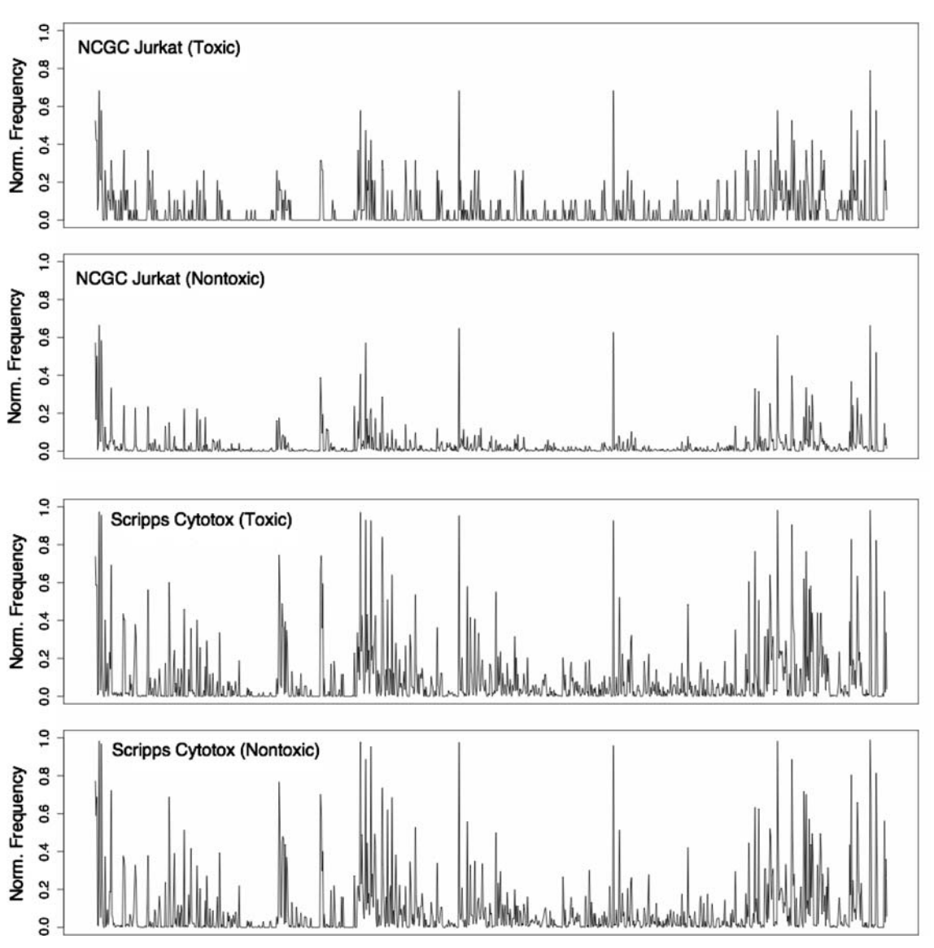
Explaining Poor Model Performance
Training set for model
Poor predictions on test set
Both test set classes look like the toxic class in the training set
Guha & Schurer, J. Comp. Aided. Molec. Des., 2008, 22, 367

Slide 23
Summary
Fingerprints are a useful representation for molecules – fast, objective, compact
But are applicable to other domains and objects
Can be generated from arbitrary datasets (e.g. text) or objects (e.g. networks)
Useful for various tasks – search, prediction, clustering
The fingerprint package provides a domain agnostic way to handle binary fingerprints

Slide 25
Comparing Clusterings
Generate multiple representations of a set of molecules
How differently do these representations cluster?
Measure correlation of clusters using cophenetic coefficient
A variety of R packages to support this
dendextend, clValid

Slide 26
Comparing Clusterings

Slide 27
Comparing Clusterings
Pairwise cophenetic correlations for clusterings generated using different fingerprints
Pubchem CDK Extended CDK Graph MACCS
Pubchem 1.0000000 0.7075479 0.6879805 0.5752923
CDK Extended 0.7075479 1.0000000 0.8050349 0.7386863
CDK Graph 0.6879805 0.8050349 1.0000000 0.7288428
MACCS 0.5752923 0.7386863 0.7288428 1.0000000

